Slide 1
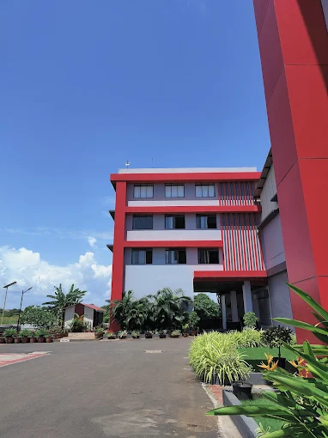

REGULATORY AFFAIRS
By Regulatory Affairs Team

Slide 2
CONTENTS
01
Product License CLA/SLA
Submitted, Approved, Inprocess, Queries, Products in pipeline
02
Global Registrations
Countrywise product registration status (registered / ongoing)
03
Technical Dossier
Section-Wise schedule for WHO Technical Dossier (TD)
04
Implementation
IVDR 2017/746 implementation and Launch of regulatory update forum
05
Quality Objectives
Current status of quality objectives 2025
06
QMS Certifications
ISO 13485, MDSAP, IVDR 2017/746 certificates

Slide 3
Product Licensing
Central and State Licensing Authority
July 2025 - December 2025

Slide 4



1. Approvals, Submission & Inprocess (July 2025 - December 2025)
Approved
Site I - 04 products Site V - 02 products
Site I - 21 products Site V - 04 products
Site I -04 products
Site I - 29 products Site V - 06 products
Submitted
Site I - 04 products Site V - 02 products
Site I - 53 products Site V - 14 products
NA
Site I - 57 products Site V - 16 products
Inprocess
Site V - 02 products
Site I - 32 products Site V - 10 products
NA
Site I - 32 products Site V - 12 products
Test license
Manufacturing license
Condition fulfillment
Total

Slide 5
2. Inprocess Applications (Overall)
TEST LICENSE
MANUFACTURING LICENSE
Query responded: 08
Under query: 03
Query responded: 55
Under query: 01
RETENTION LICENSE
INPROCESS
CONDITION FULFILLMENT
Query responded: 27
Query responded: 09
Under query: 06
NEW IVD
CLINICAL INVESTIGATION
Under query: 07
Query responded: 01
Sr. No. | Type of license | Product Name | Site | Status
01 | Test license | Truenat® Dengue/Zika (Reapplication) | I | Awaiting CDSCO approved testing lab
02 |  | Truenat® CHPV | I & V | No CDSCO approved predicate device
03 | Manufacturing license | Truenat® KFDV | I | Approval of Form MD-29
04 | New IVD | Truenat® KFDV | I | Clinical evaluation data on specimen collected from feild and statistically powered sample size
 |  | Truenat® Inf A,B/COVID-19, Truena^{t®} Nipah, Truenat® COVID-19, Truenat® SARS CoV-2, Truenat® Beta CoV & TruemixTM COVID-19 | I | Recent Clinical evaluation data (last 1 year)
05 | Condition Fulfillment | Truenat® MTB, Truenat® MTB Plus, Truenat® MTB RIF Dx, Truenat® HCV, Truenat® CT & Truenat® COVID-19 | V | Stability study and PER for EPTB Sample as claimed in IFU

Slide 6
3. Products in Pipeline
01
02
03
04
05
06
07
08
Truecyte
AI based digital pathology
(Awaiting product details)
Trueprep Mag V2
(Awaiting product details)
Trueamp Mini
Real Time Multiplex qPCR Analyzer
(Awaiting approved user manual)
Trueprep Mag V3
(Awaiting product details)
Trueamp HPV-HR Genotyping
Real Time PCR Test for Human Papillomavirus High Risk Types 16/18/33/35, 31/39/45, 51/52/56/58, 59/66/68
(Awaiting finalised product details)
Trueamp CureDx-TB
Real-time reverse transcription polymerase chain reaction (RT-PCR) assay for the qualitative assessment of host-response mRNA biomarkers associated with Mycobacterium tuberculosis infection
(Awaiting finalised product details)
Truepoc
Integrated point-of-care NAAT platform
(Awaiting product details)
Truenat Ebola-Marburg
Chip-based Real Time PCR Test for Ebola and Marburg virus
(No provision for International Testing Sites)

Slide 7
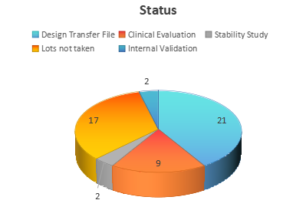
4. Manufacturing License Status (to be applied)
LOTS (03) NOT TAKEN
Truenat® Staph/ MRSA
Truenat® Rota V (Reapplication)
Truenat® Mucormycosis (Reapplication)
Truenat® Rubella / Measles
Truenat® Mumps
Truenat® Positive Control Kit - Panel VI
Truenat® Positive Control Kit - Panel VII
Truenat® Positive Control Kit - Panel VIII
Truenat® Toxo
Truemix™ HCV (Reapplication)
Truemix™ HBV (Reapplication)
Truemix™ HIV-1/HIV-2 (Reapplication)
Truemix™ HPV-HR Plus
Truemix™ MPX
Truenat® HMPV
Truenat® JEV (Reapplication)
Truenat® SCD (Reapplication)
Truenat® RSV (Reapplication)
DESIGN FILE
Truemix™ HPV-HR 16/18
Truemix™ Zika / Dengue / Chikungunya
Truemix™ Beta CoV
Truemix™ SARS CoV-2
Truemix™ Carb-R
Trueamp™ MDR-TB Plus
Truemix™ BCR-ABL
Truemix™ MTB Plus
Truemix™ MTB-INH
Truemix™ MTB Ultima
Truemix™ Sepsis Panel
Truemix™ Respiratory Panel
Truebact™ MTB DST
Truemix™ MTB Rif Dx
Truenat® HMPV / COVID-19,Influenza
Truenat® HMPV and M. pneumonia
Truenat® H5N1
Trueamp™ Respiratory Panel
Sickelcert™
Truedetect™
Truetell™/Promilless™ 0.03%
Truenat® Syphilis
Internal Validation
Truetell™/Promilless™ 0.02%
Truetell™/Promilless™ 0.05%
CLINICAL EVALUATION
Truenat® MTB Ultima
Truenat® HPV-HR 16/18
Truenat® Zika
Truenat® Brucella
Truenat® RSV
Truenat® Malaria Pv/Pf Hi-Sens
Truenat® Salmonella-FQ
Truemix™ HPV-HR Plus
Truelyse™ Buffer
STABILITY
Truenat® MPX (more 2 lots)
Truetell™/Promilless™ 0.0%

Slide 8
GLOBAL REGISTRATIONS
July 2025 - December 2025

Slide 9

4. Global Registrations (July 2025 - December 2025)
SOUTH AMERICAN
CONTINENT
AFRICAN
CONTINENT
Brazil
Peru
Colombia
Paraguay
Bolivia
Morocco
South Africa
Nigeria
Kenya
Zambia
Ghana
Botswana
Gambia
ASIAN
CONTINENT
EUROPEAN CONTINENT
NORTH & CENTRAL
AMERICAN CONTINENT
Iran
Taiwan
Thailand
Vietnam
Philippines
UAE
United Kigdom
Romania
Azerbaijan
El Salvador
Guatemala
Honduras
Nicaragua
Panama
Costa Rica
Mexico

Slide 10
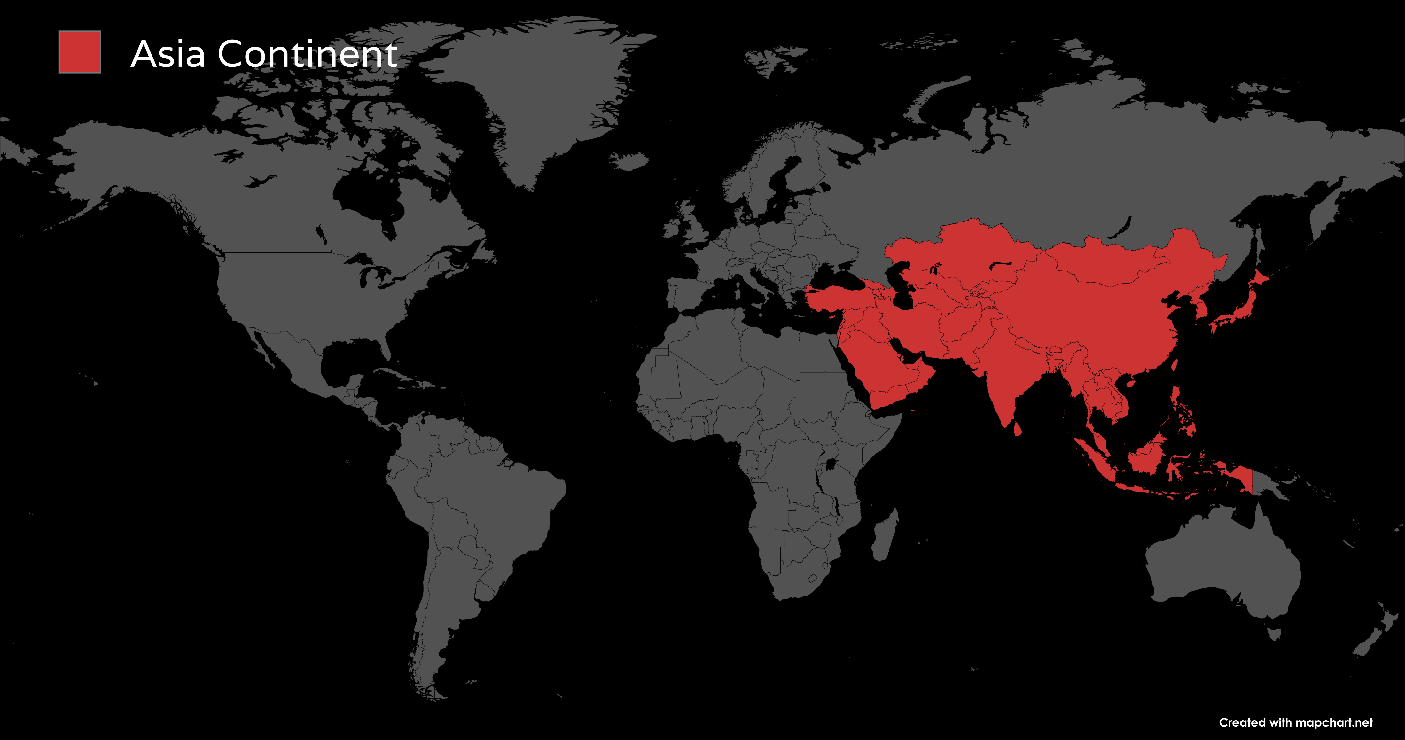
4. Global Registrations (July 2025 - December 2025)

Slide 11
4. Global Registrations (July 2025 - December 2025)
Country | Regulator | No. of products registered | No. of products (Registration Ongoing)
Iran | Iranian Food and Drug Administration | NA | 41
Taiwan | The Taiwan Food and Drug Administration (TFDA) | NA | 15
Thailand | Thai Food and drug Administration | NA | 21
Vietnam | Ministry of Health | NA | 06
Philippines | Center for Device Regulation, Radiation Health, and Research (CDRRHR) | 01 | 01
UAE | Ministry of Health and Prevention (MOHAP) | 05 | NA

Slide 12
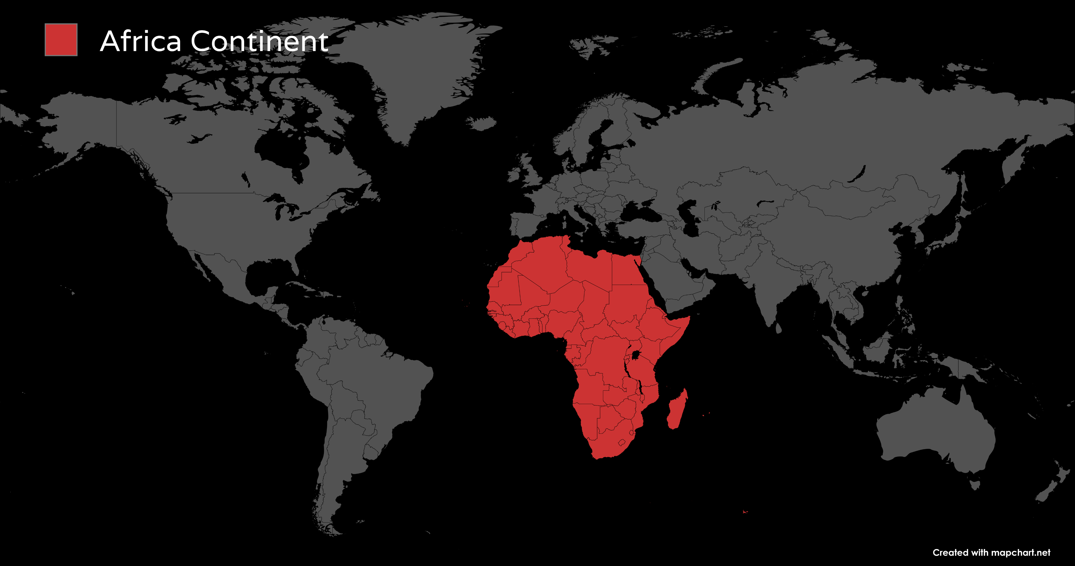
4. Global Registrations (July 2025 - December 2025)

Slide 13
4. Global Registrations (July 2025 - December 2025)
Country | Regulator | No. of products registered | No. of products (Registration Ongoing)
Morocco | Directorate of Medicines and Pharmacy | NA | 39
South Africa | South African Health Products Regulatory Authority (SAHPRA) | NA | 08
Nigeria | National Agency for Food and Drug Administration and Control (NAFDAC) | NA | 02
Kenya | Pharmacy and Poisons Board (PPB) | NA | 02
Zambia | Zambia Medicines Regulatory Authority (ZAMRA) | NA | 01
Ghana | Food and Drugs Authority (FDA) | NA | 20
Botswana | Botswana Medicines Regulatory Authority (BoMRA) | NA | 09
Gambia | Medicines Control Agency (MCA) | NA | 10

Slide 14
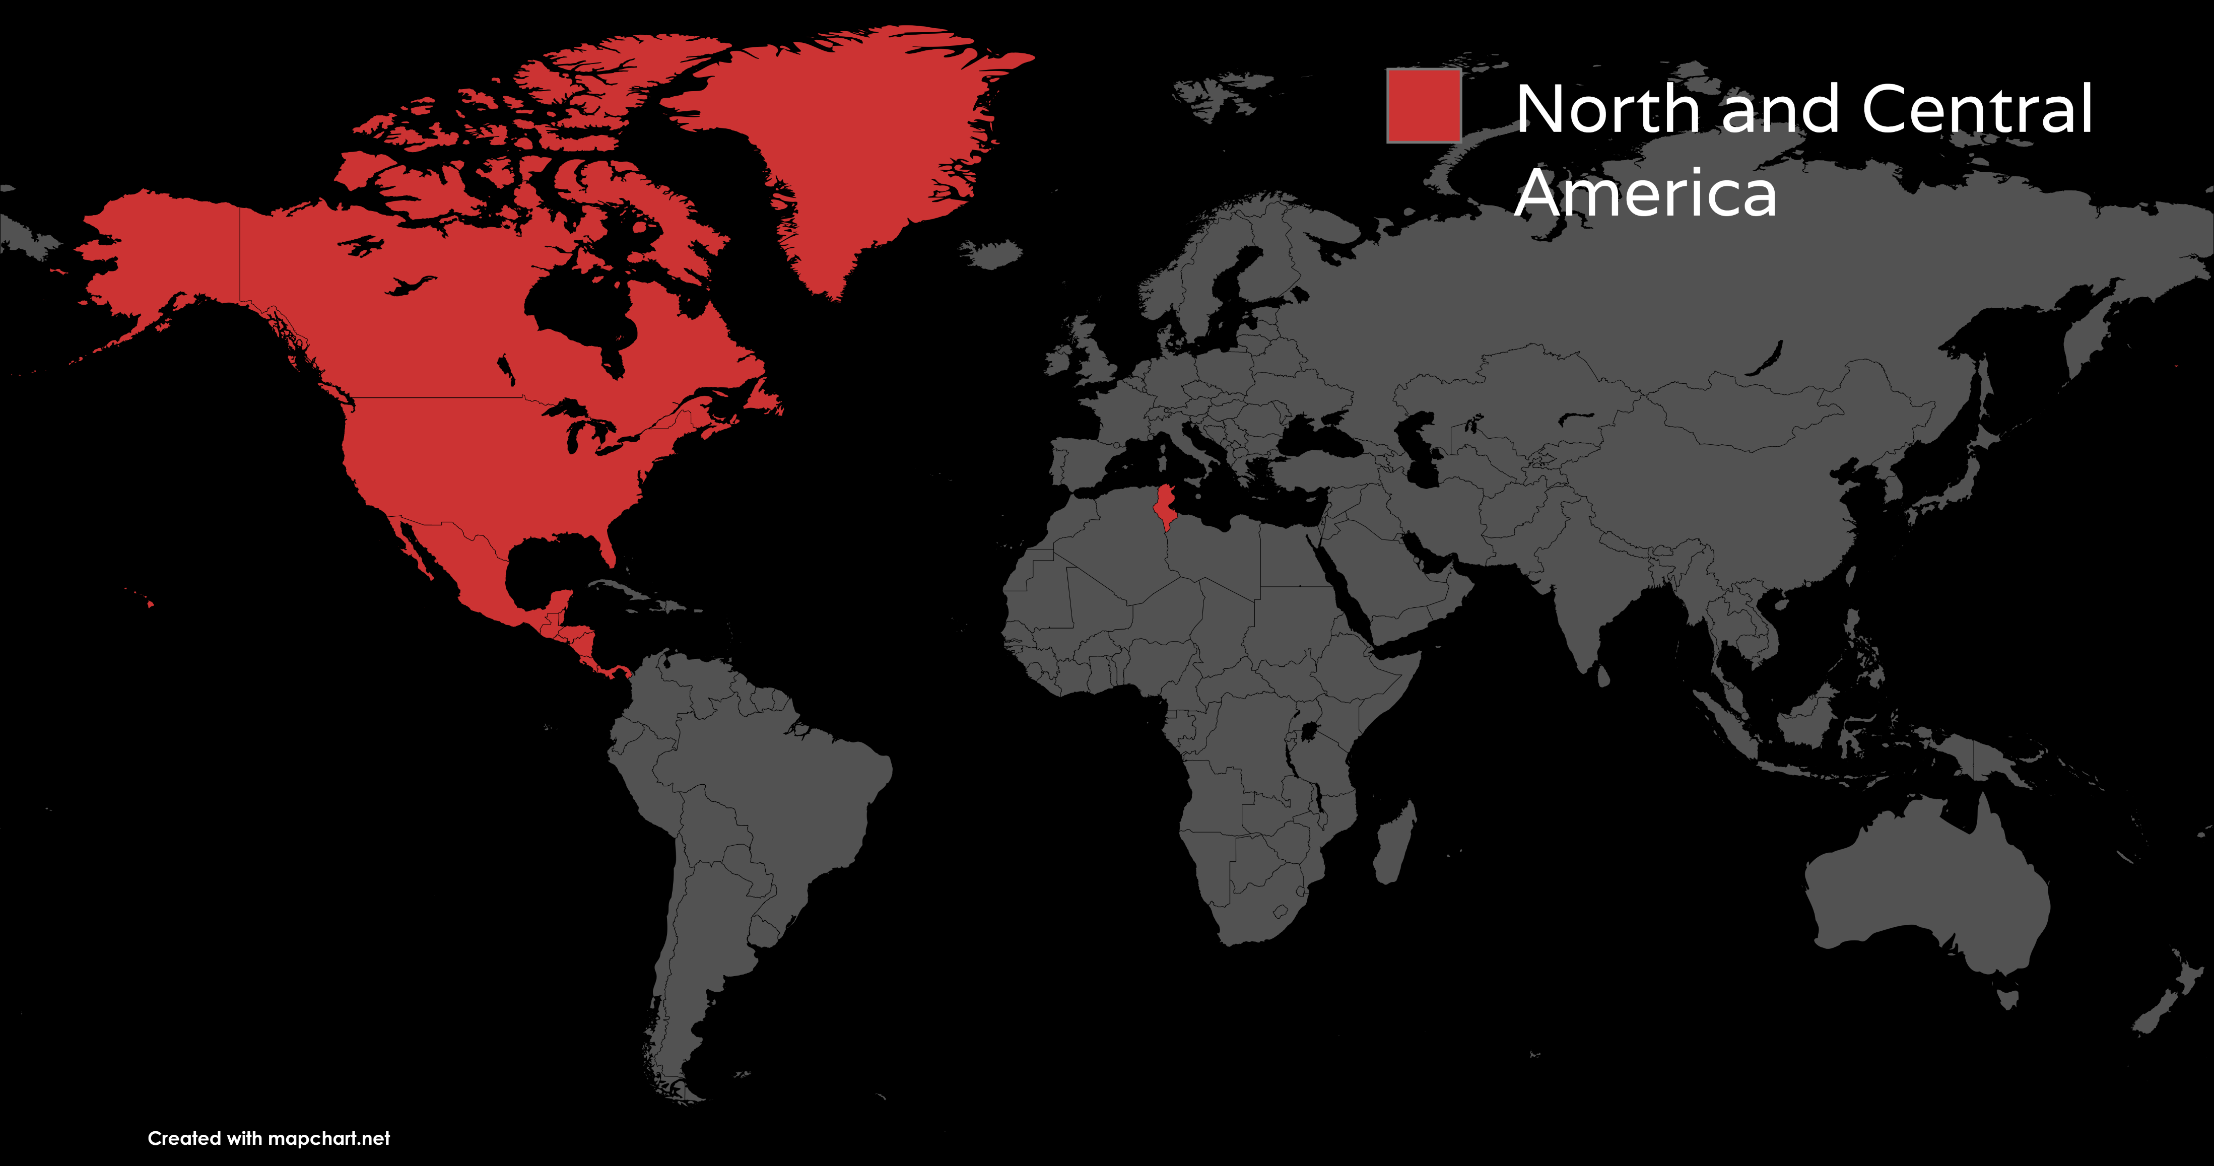
4. Global Registrations (July 2025 - December 2025)

Slide 15
4. Global Registrations (July 2025 - December 2025)
Country | Regulator | No. of products registered | No. of products (Registration Ongoing)
El Salvador | National Directorate of Medicines | 11 | 03
Guatemala | Departamento de Regulacion y Control de Productos Farmacéuticos y Afines (DRCPFA) | 35 | 04
Honduras | Health Regulation Agency (ARSA) | 06 | 11
Nicaragua | National Health Regulatory Authority | NA | 01
Panama | Ministry of Health (MINSA) | NA | 10
Costa Rica | Ministry of Health (MOH) | NA | 18
Mexico | Comision Federal para la Proteccion contra Riesgos Sanitarios (COFEPRIS) | NA | 07

Slide 16
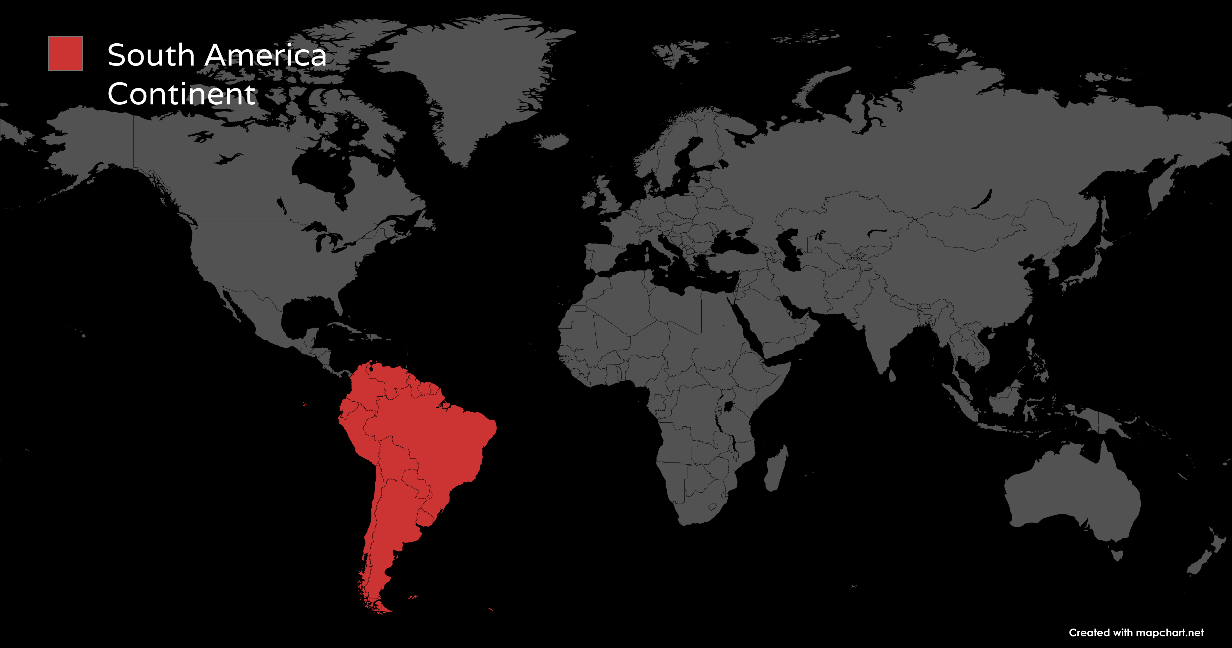
4. Global Registrations (July 2025 - December 2025)

Slide 17
4. Global Registrations (July 2025 - December 2025)
Country | Regulator | No. of products registered | No. of products (Registration Ongoing)
Brazil | Agencia Nacional de Vigilancia Sanitaria (ANVISA) | 03 | 04
Peru | Direccion General de Medicamentos, Insumos y Drogas (DIGEMID) | 01 | 07
Colombia | National Food and Drug Surveillance Institute (INVIMA) | NA | 11
Paraguay | National Directorate of Health Surveillance (DINAVISA) | NA | 07
Bolivia | La Agencia Estatal de Medicamentos y Tecnologías en Salud (AGEMED) | 09 | 01

Slide 18
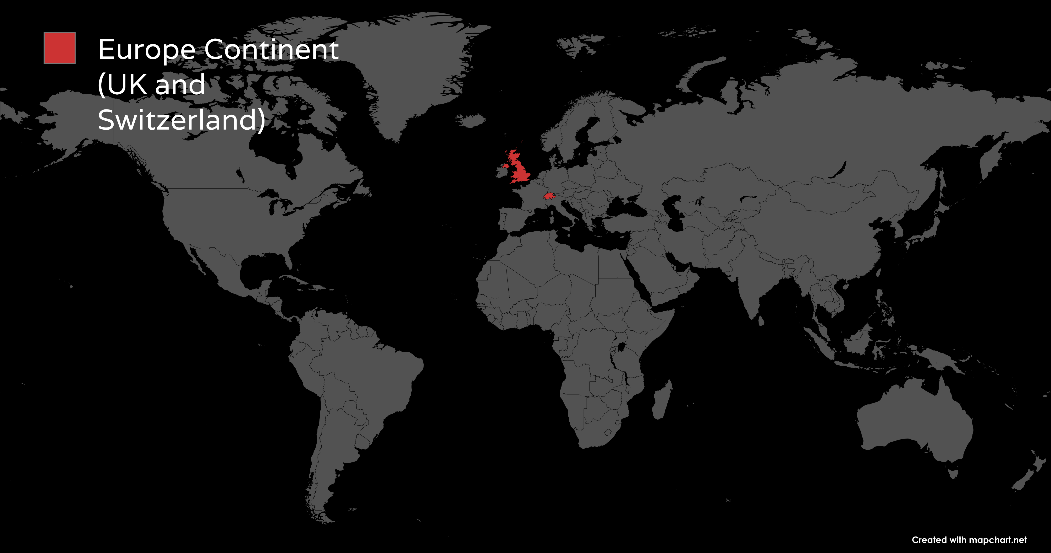
4. Global Registrations (July 2025 - December 2025)

Slide 19
4. Global Registrations (July 2025 - December 2025)
Country | Regulator | No. of products registered | No. of products (Registration Ongoing)
United Kingdom | Medicines and Health care products Regulatory Agency (MHRA) | NA | 42
Romania | National Agency for Medicines and Medical Devices (NAMMD) | NA | 03
Azerbaijan | Analytical Expertise Center (AEC) | NA | 06

Slide 20
WHO Technical dossier
Section-Wise Schedule for Technical dossier(TD) and Related documents

Slide 21


Letter of Agreement
Month-wise progress for Truenat® MTB Plus WHO PreQ TD Submission
Completed
Coordination with cross-functional teams for data as per GAP assessment prepared
Verification and finalization of analytical performance study data
Artwork review and verification for compliance.
Preparation of sections for Technical Dossier (TD)
Compilation of TD with supporting documents
Review of TD sections stakeholders
Preparation of the pre-submission form
Inprocess
1st Dossier Screening of WHO recieved (5/12/2025)
Coordinating for data as per screening review
October to November
July to October
Finalization and submission of pre-submission form
Allotment of PreQ number (07/10/2025)
Pre-submission call with WHO
Signing of Letter of Agreement
Fees payment (26/11/2025)
Updating and compilation of TD with all review comments
Submision of TD to WHO (27/11/2025)
December

Slide 22
Letter of Agreement
Preparation & Review Progress Track for Truenat® MTB-RIF Dx WHO PreQ Submission
Incorporating all recieved comments and resharing section 1 and 2 for second review
Sharing Section 4.0 (Clinical evidence) for review
Sharing of Analytical summary for third review
Review of Artwork(Pouch) recieved
Finalization and submission of pre-submission form
Pre-submission call with WHO
Allotment of PreQ number (05/12/2025)
Signing of Letter of Agreement
Completed
Preparation and sharing of EP checklists
Reviewing of documents
Sharing of Analytical study summary for review
Incorpation of reviewed content and sharing for second review
Inprocess
8/12/2025-Till date
5/12/2025-6/12/2025
3/12/2025- 4/12/2025
Coordination with cross-functional teams for data to be included in the dossier.
Preparaton of Pre-submission form and shared the same for review
Initiation of TD preparation
Review of Artwork recieved(Kit Label)
Review of Pack insert (Intended Use)
Preparation of Risk documents
Compilation of annexures
1/12/2025-2/12/2025
5/12/2025-6/12/2025
Sharing of Section 6.0 and Stability summary data for review
Incorporating review commnets and sharing the same for second reviewreview
Sharing section 1.0 for review

Slide 23
QUALITY OBJECTIVES

Slide 24
Quality Objective- Year 2025
Quality Objective 1 : To register Truenat® CT/NG, Truenat® MTB-INH, Truenat® HCV Under IVD Regulation (EU) 2017/746 of European Parliament and of the Council.
Quality Indicator 1: Truenat® CT/NG under IVDR, 2017
Task | Quality Indicator | Task % allotted | Status | Task % completed
T1 | Certification by NB | 70 | Ongoing | 75
T2 | EU DOC | 15 | Ongoing | 0
T3 | Updation of Annex IV | 15 | Ongoing | 0
TASK % (TOTAL) |  | 100% | NA | 75%

Slide 25
Quality Objective- Year 2025
Quality Objective 1: To register Truenat® CT/NG, Truenat® MTB-INH, Truenat® HCV Under IVD Regulation (EU) 2017/746 of European Parliament and of the Council.
Quality Indicator 2: Truenat® MTB-INH under IVDR, 2017
Task | Quality Indicator | Task % allotted | Status | Task % completed
T1 | Technical Dossier preparation | 70 | Ongoing | 40
T2 | Technical Dossier review by all stake holders | 15 | Ongoing | 0
T3 | Technical Dossier Submission to Notified body | 15 | Ongoing | 0
TASK % (TOTAL) |  | 100% | NA | 40%

Slide 26
Quality Objective- Year 2025
Quality Objective 1 : To register Truenat® CT/NG, Truenat® MTB-INH, Truenat® HCV Under IVD Regulation (EU) 2017/746 of European Parliament and of the Council.
Quality Indicator 3: Truenat® HCV under IVDR, 2017
Task | Quality Indicator | Task % allotted | Status | Task % completed
T1 | Technical Dossier preparation | 70 | Ongoing | 75
T2 | Technical Dossier review by all stake holders | 15 | Ongoing | 0
T3 | Technical Dossier Submission to Notified body | 15 | Ongoing | 0
TASK % (TOTAL) |  | 100% | NA | 75%

Slide 27
Quality Objective- Year 2025
Quality Objective 2 : To plan and implement EN ISO 14001:2015 [Environnental management systems Requirements with guidance for use] at Molbio Diagnostics Limited.
Quality Indicator 1: Gap Assessment
Task | Quality Indicator | Task % allotted | Status | Task % completed
T1 | Gap Analysis | 50 | Completed | 100
T2 | Inter - Department Meeting | 50 | Ongoing | 30
TASK % (TOTAL) |  | 100% | NA | 65%
Quality Indicator 2: Implementation
Task 1: Procedures developed in accordance with the guidelines - 30% Completed

Slide 28
Quality Objective- Year 2025
Quality Objective 3 : To plan and implement IEC 62366-1 : 2015 [Medical devices Part 1: Application of usability engineering to medical devices]
Quality Indicator 1: Gap Assessment
Task | Quality Indicator | Task % allotted | Status | Task % completed
T1 | Gap Analysis | 50 | Completed | 100
T2 | Inter - Department Meeting | 25 | Completed | 100
T3 | Feedback Assessment and Conclusion | 25 | Completed | 100
TASK % (TOTAL) |  | 100% | NA | 100%
Quality Indicator 2: Implementation
Task 1: Procedures developed in accordance with the guidelines - 30% Completed

Slide 29
IMPLEMENTATION
July 2025 - December 2025

Slide 30
Stage 1
Launch of IVDR Project
Gap Assessment
Status: COMPLETED
Stage 2
Appointment of AR and NB
Registration of Economic Operator in Actor Module of EUDAMED
Status: COMPLETED
Stage 4
Implementation of IVDR Compliant Procedures
Registration of Class A devices*
Status: COMPLETED
Stage 3
Appointment of PRRC
Classification of Products
Status: COMPLETED
Stage 5
IVDR Audit
IVDR Certification
Status: COMPLETED
Implementation of IVDR and Registration Products under IVDR
COMPLETED
IVDR QMS Certificate Received
Truenat® CT-NG registered
*Truelab and Trueprep® Devices, Trueprep® and STABILYSE® reagents are registered
**Truenat® CTNG is registered. Truenat® HCV, HPV-HR Plus, MTB-INH and MTB Ultima are in process

Slide 31




Regulatory Update Forum
Launched Regulatory Update Forum
Designed to track and communicate applicable regulatory updates and amendments on a monthly basis
Targeted Communication
Updates and amendments issued by various regulatory bodies will be shared with all impacted departments
Release Summary
delivers a clear and concise summary of updates and amendments issued by various regulatory authorities
Goal
Stay updated with current regulatory requirements to ensure timely compliance, minimize regulatory risks and maintain audit readiness
What’s New?

Slide 32
QMS CERTIFICATES
July 2025 - December 2025

Slide 33



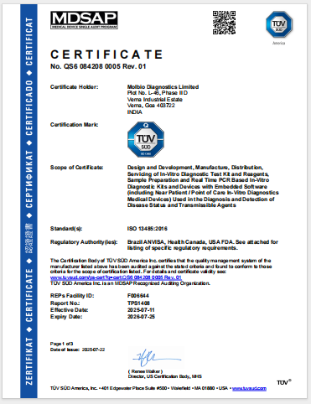
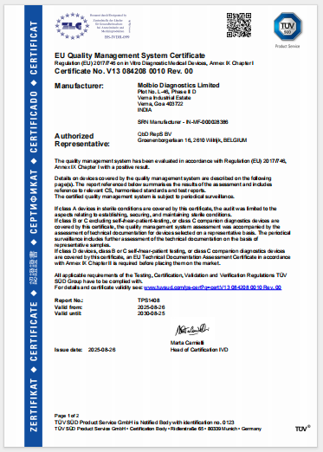
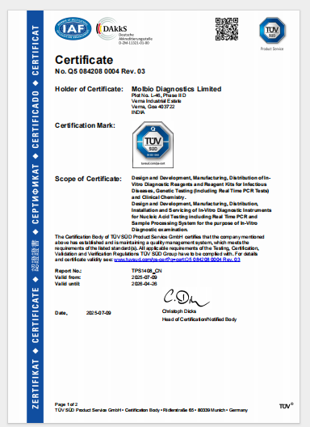

CERTIFICATIONS
Successfully achieved QMS certificates:
01
02
03
8
MDSAP Certificate
Valid from: 11/07/2025
Valid until: 25/07/2026
EU IVDR Certificate
Valid from: 26/08/2025
Valid until: 25/08/2030
ISO Certificate
Valid from: 09/07/2025
Valid until: 26/04/2026

Slide 34
THANK YOU

